Slide 1


BABU BANARSI DAS INSTITUTE OF TECHNOLOGY AND MANAGEMENT
BABU BANARASI DAS INSTITUTE OF
TECHNOLOGY AND MANAGEMENT

Slide 2
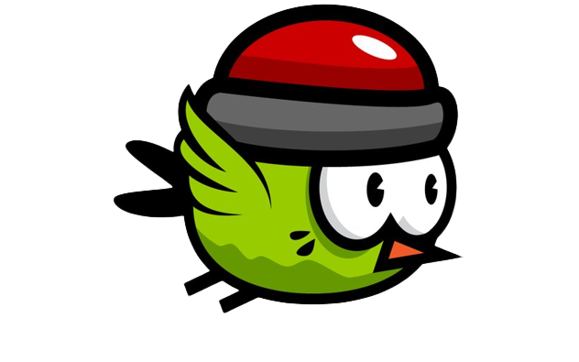
BABU BANARSI DAS INSTITUTE OF TECHNOLOGY AND MANAGEMENT
MINI PROJECT
FLAPPY BIRD
By Using Python

Slide 3
BABU BANARSI DAS INSTITUTE OF TECHNOLOGY AND MANAGEMENT
Presented By :- Abhay Gupta
Roll no :- 2100540100004
Guided By :- Mr. Shivam Dixit Sir
Submitted for the partial fulfillment of
B.Tech
in
CSE

Slide 4
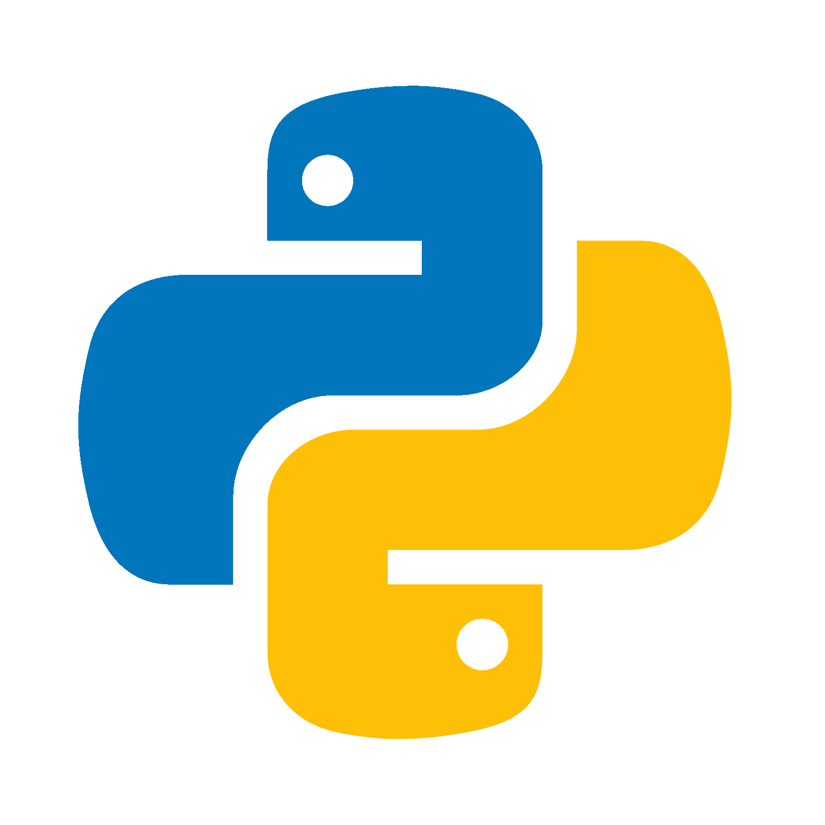
BABU BANARSI DAS INSTITUTE OF TECHNOLOGY AND MANAGEMENT
Language Used
PYTHON

Slide 5
BABU BANARSI DAS INSTITUTE OF TECHNOLOGY AND MANAGEMENT
Introduction To Python
Python Is a general Programming language that is often
applied in scripting roles.
So, Python is programming language as well as
scripting language.
Python is also called interpreted language.

Slide 6
BABU BANARSI DAS INSTITUTE OF TECHNOLOGY AND MANAGEMENT
Program Language
A Program is executed .
A program in general is a sequence of instructions written so that a computer can perform
certain task
Scripting Language
A Program is interpreted .
A script is code written in a scripting language.A scripting language is nothing but a type of
programming language in which we can write code to control another
software application.

Slide 7
BABU BANARSI DAS INSTITUTE OF TECHNOLOGY AND MANAGEMENT
Scope of PYTHON
Science - Bioinformatics
System Administration - Unix , Web Logic , Web Sphere
Web Application Development - CGI , Jython-Servlets
Testing scripts

Slide 8
BABU BANARSI DAS INSTITUTE OF TECHNOLOGY AND MANAGEMENT
What can I do with Python
System Programming
Graphical User Interface Programming
Internet Scripting
Component Integration
Database Programming
Gaming Images , XML , Robot and mor

Slide 9
BABU BANARSI DAS INSTITUTE OF TECHNOLOGY AND MANAGEMENT
Who Use Python Today
Google makes extensive use of Python in its
web search system and employs Python’s Creator.
Intel , Cisco , Hewlett-Packard , Seagate , Qualcomm
and IBM use Python for hardware testing.
The YouTube video sharing service is largely written
in Python.

Slide 10
BABU BANARSI DAS INSTITUTE OF TECHNOLOGY AND MANAGEMENT
Why do people use Python ?
Python is object oriented
Easy To Use
It’s free ( Open Source )
It’s Powerful
It’s portable

Slide 11
BABU BANARSI DAS INSTITUTE OF TECHNOLOGY AND MANAGEMENT
Successfully Completed A Coursera course Based On
Crash Course on Python

Slide 12
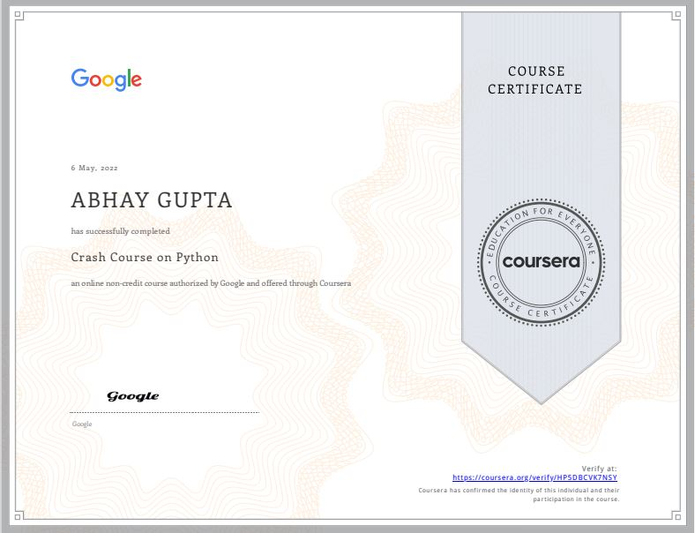
BABU BANARSI DAS INSTITUTE OF TECHNOLOGY AND MANAGEMENT

Slide 13
BABU BANARSI DAS INSTITUTE OF TECHNOLOGY AND MANAGEMENT
ABOUT MY MINI
PROJECT

Slide 14
BABU BANARSI DAS INSTITUTE OF TECHNOLOGY AND MANAGEMENT
The prerequisite of this project is the basic knowledge of python.
For this project, I am going to use the Virtual Studio Code IDE
and the pygame module.
Pygame is a library that is used in
creating games in Python.
It has four important things.
Game Loop
Events
Sprites
Sound

Slide 15
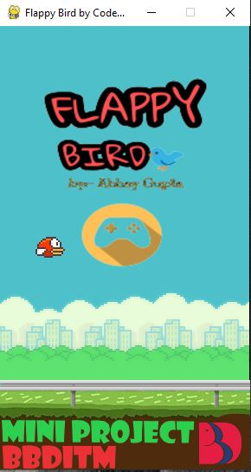
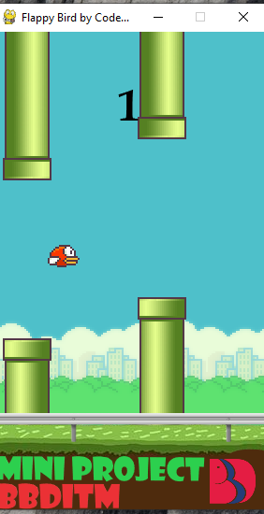
BABU BANARSI DAS INSTITUTE OF TECHNOLOGY AND MANAGEMENT

Slide 16
BABU BANARSI DAS INSTITUTE OF TECHNOLOGY AND MANAGEMENT
thank you

